Slide 1
Animal Health & Adoption Management System
Yunan Shao
Dongjun yang

Slide 2
Problem Statement
More Families have kept pets or plan to have pets but not all of them have paid enough attention to their pets’ health.
Taking pets to the clinic is inconvenient sometimes, it could waste time if there are not big problems.
Adoption is always a better option than buying a pet and can be done in a more convenient way.
Homeless animals can cause potential transmitted diseases and need to be rescued in time.

Slide 3
Solution
Pet Health
Adoption
Homeless Animal Report
Pet health data recorded periodically by pet owner.
Pet owner can send request to doctors asking for evaluation of the health condition.
Making appointment with doctor if pet is ill and need to visit the clinic.
Rescued homeless animals listed by animal healthcare organization.
Pets listed by users.
Users send report to animal healthcare organization
Reports are rearranged by priority on rescue team side.

Slide 4
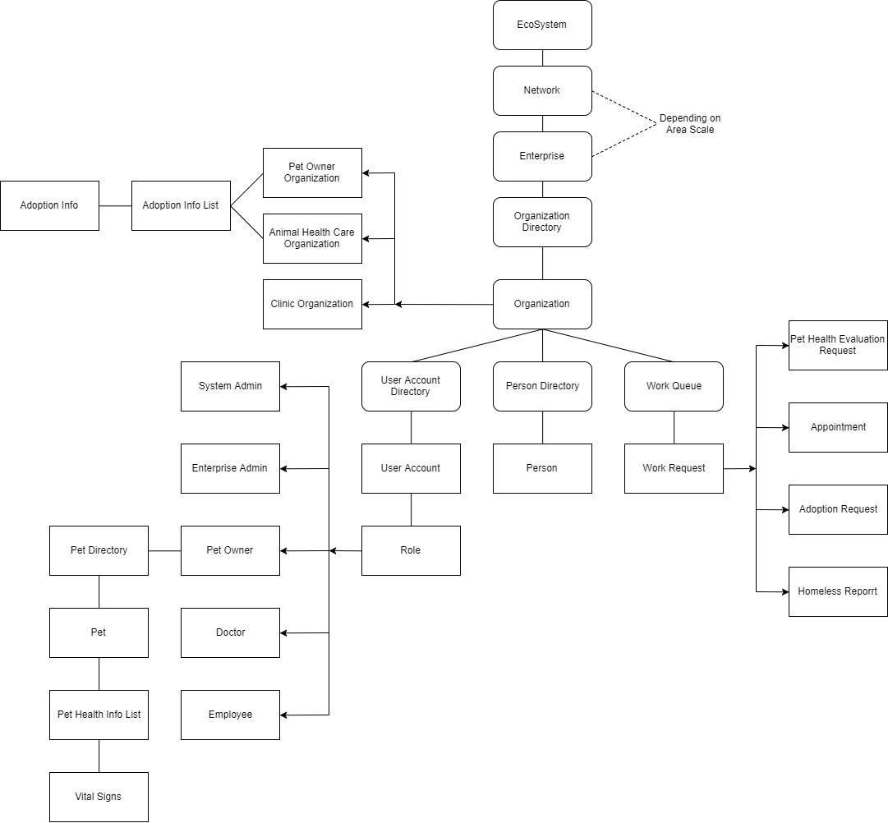
Object Model

Slide 5
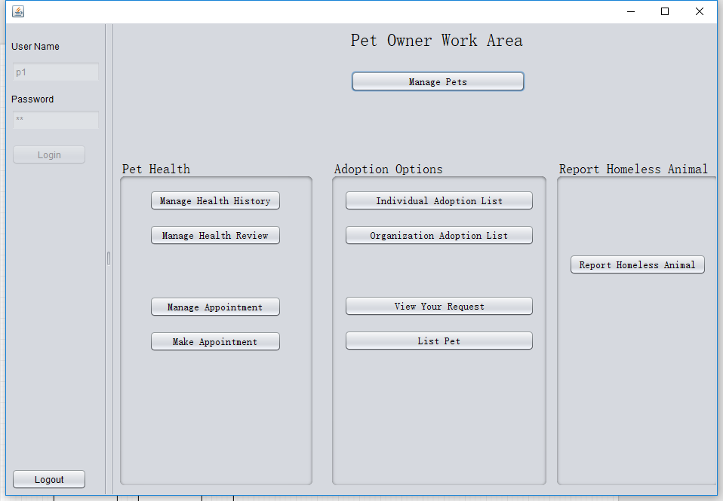
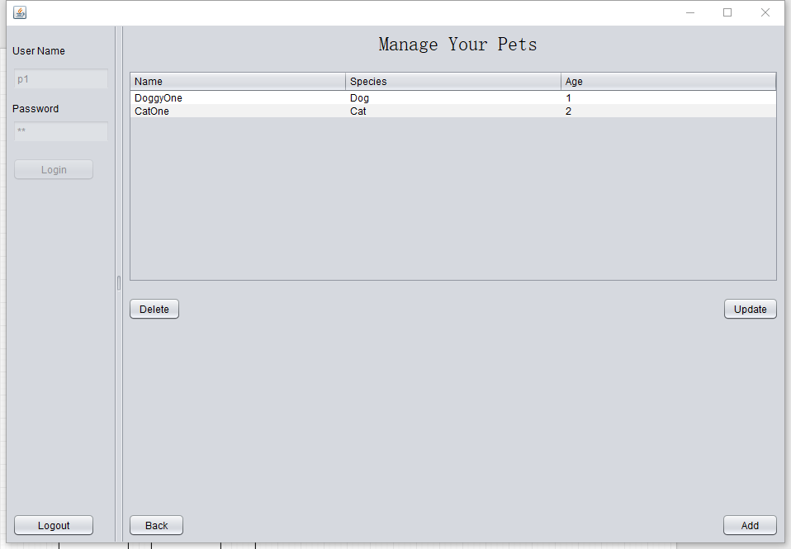
Use Case
Pet Owner Work Area
Pet Management

Slide 6
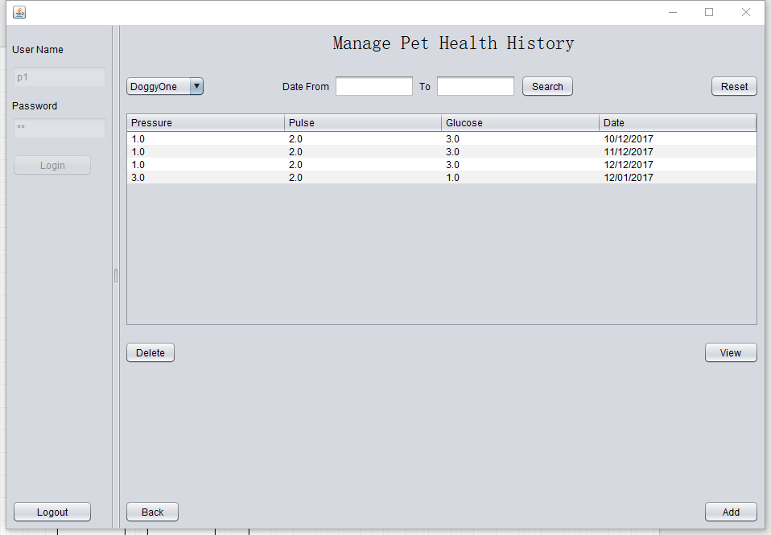
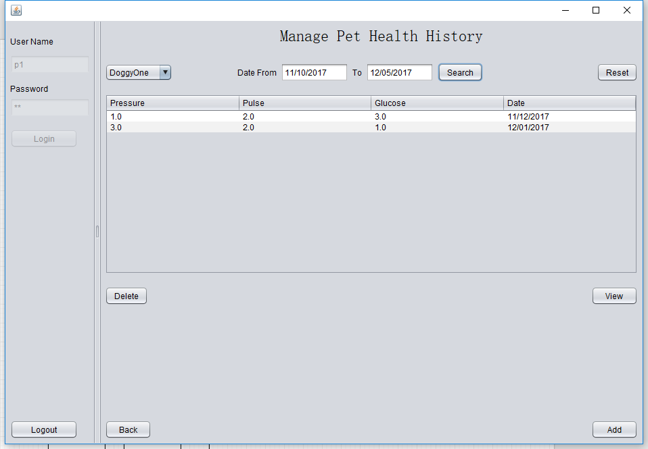
Use Case
Manage Pet Health History
Filter by record date

Slide 7
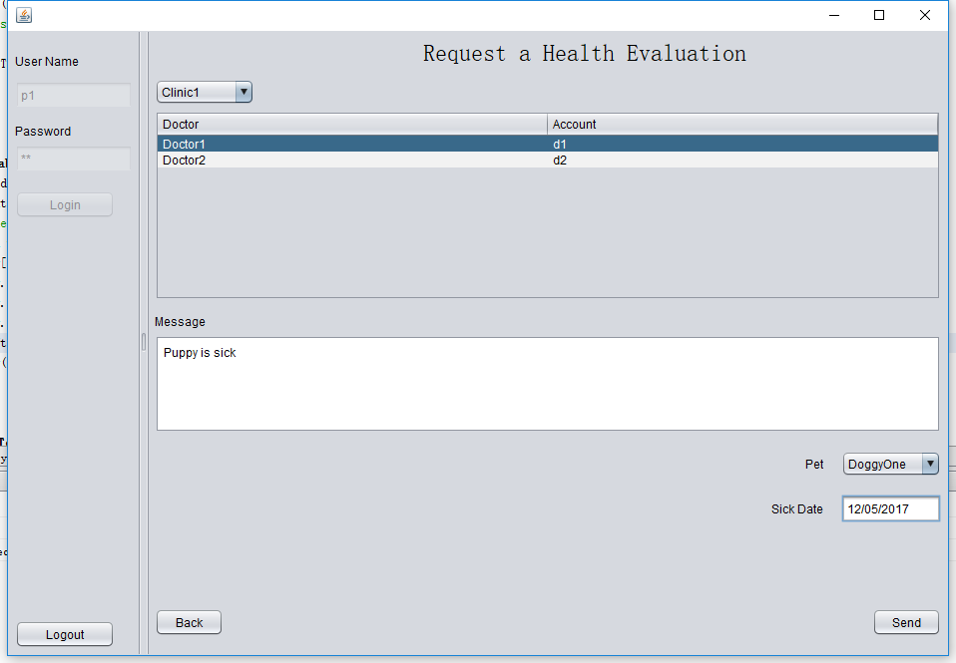
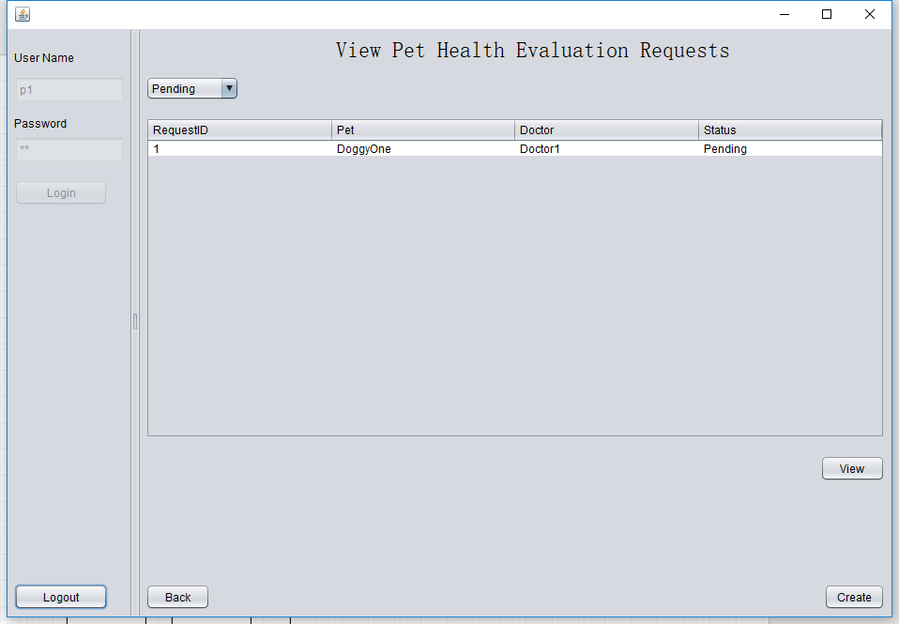
Use Case
Pet Health Evaluation Request (Pet Owner Side)

Slide 8
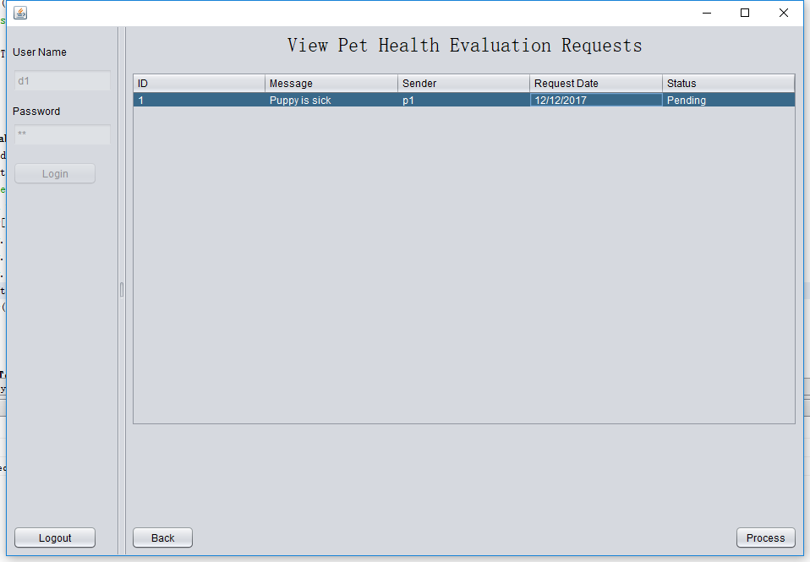
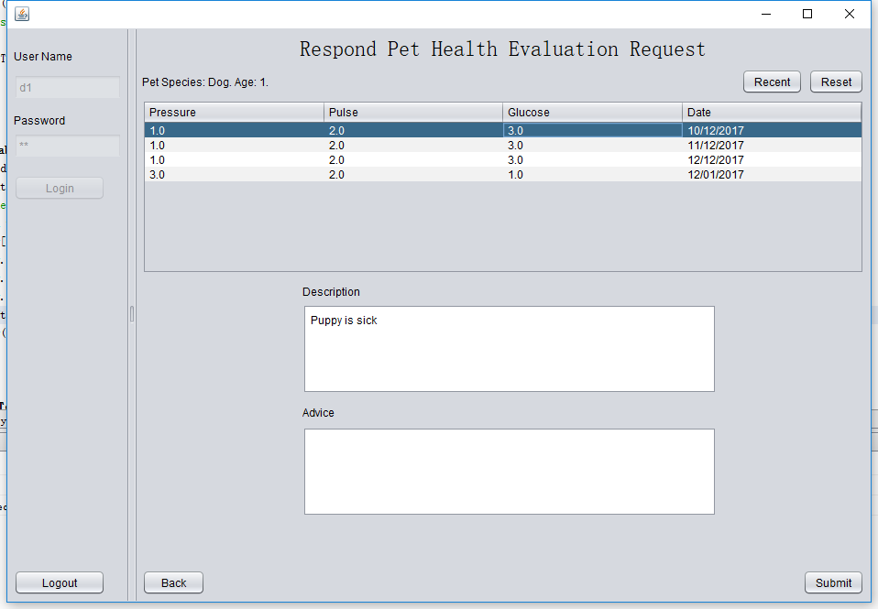
Use Case
Filter Records from 7 days before sick date to view date
Pet Health Evaluation Request (Doctor Side)

Slide 9
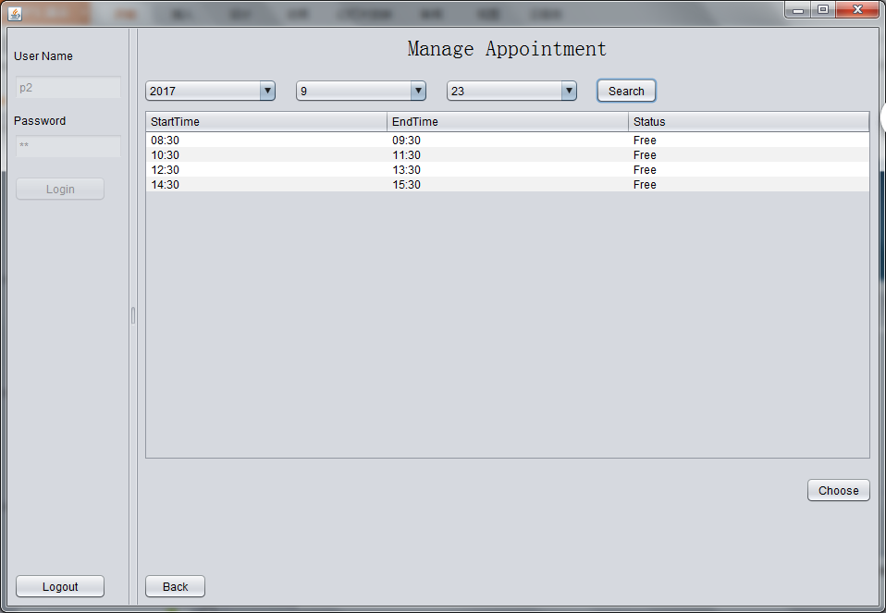
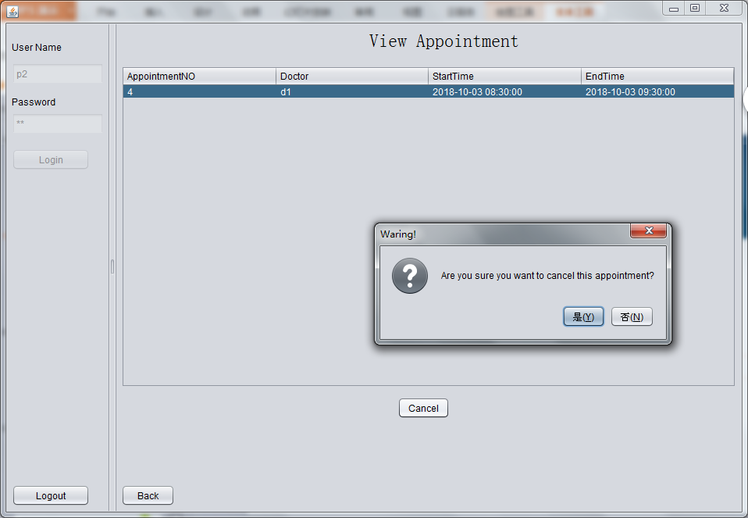
Use Case
Make appointment with doctor Manage appointment

Slide 10
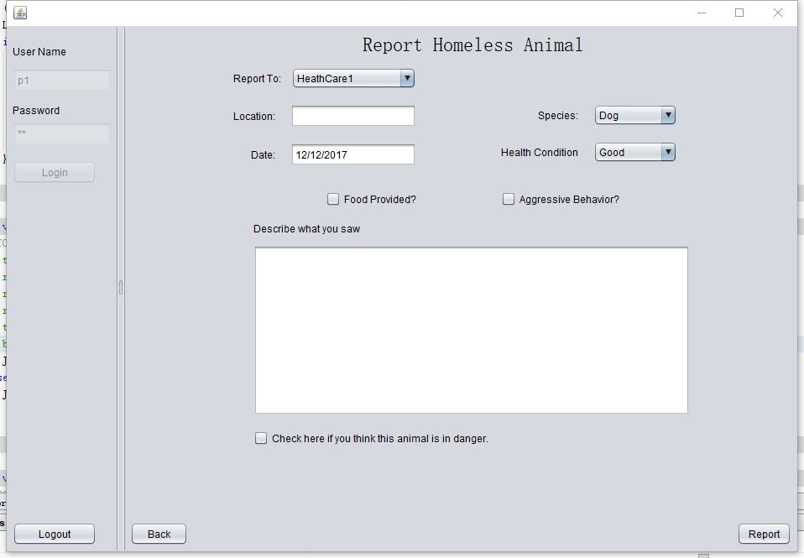
Use Case
Report Homeless Animals (Pet Owner Side)
Report is a sub class of work request
Report class has priority attribute
Priority is set by system depending on health conditions and other factors
Aggressive Behavior will set priority to High

Slide 11
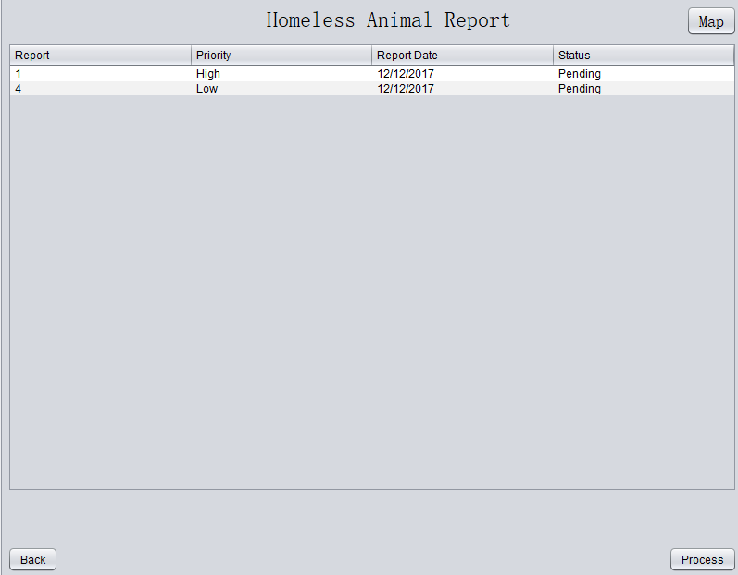
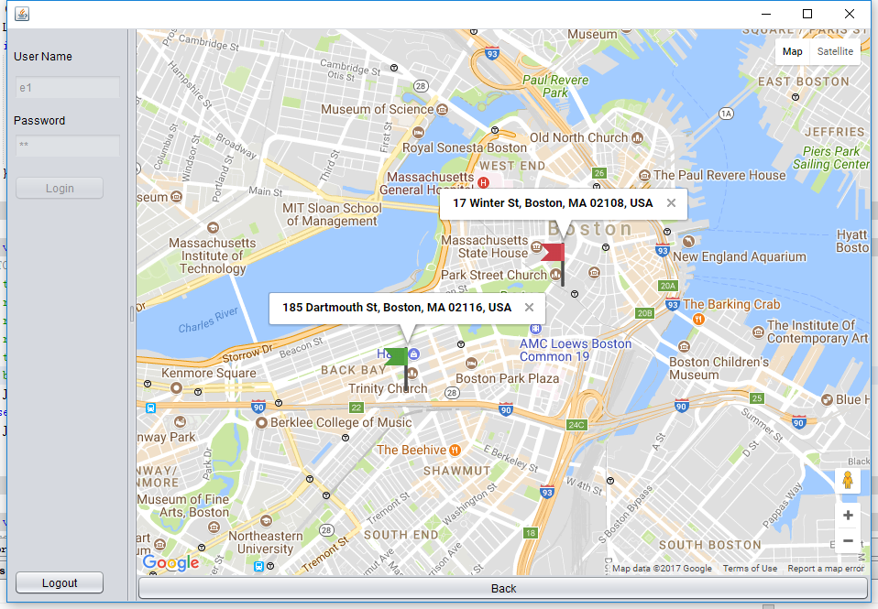
Use Case
Report Homeless Animals (Animal Health Organization Side)
Reports are sorted by priority level. Reports not resolved 15 days from view date will be reset to high priority.
Reports with geocodable location information can be marked on map.

Slide 12
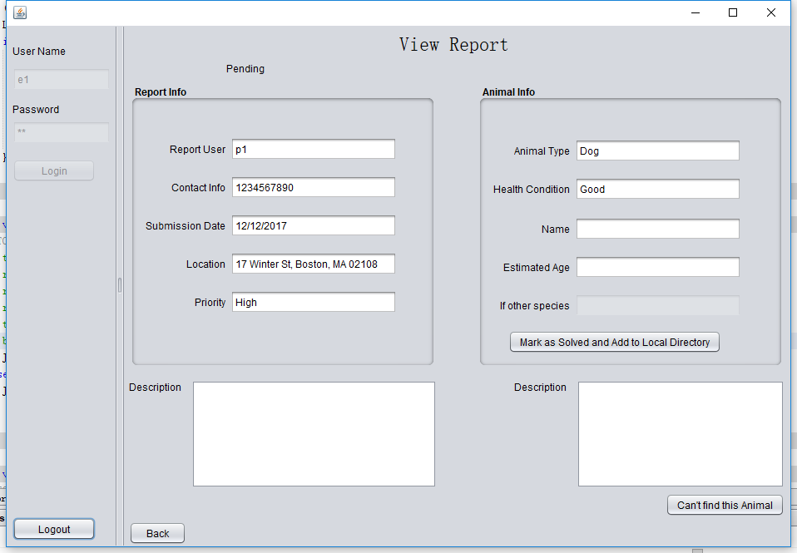
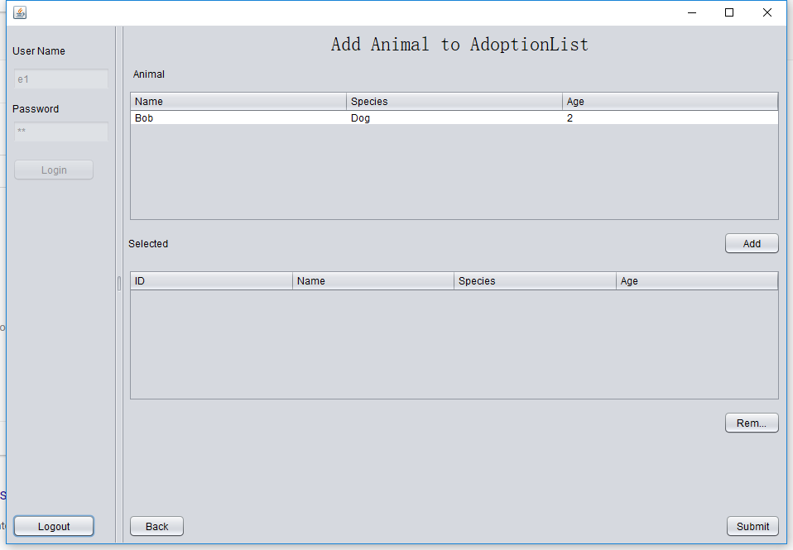
Use Case
Rescued animals will be added to department animal list which can be put on adoption list later

Slide 13
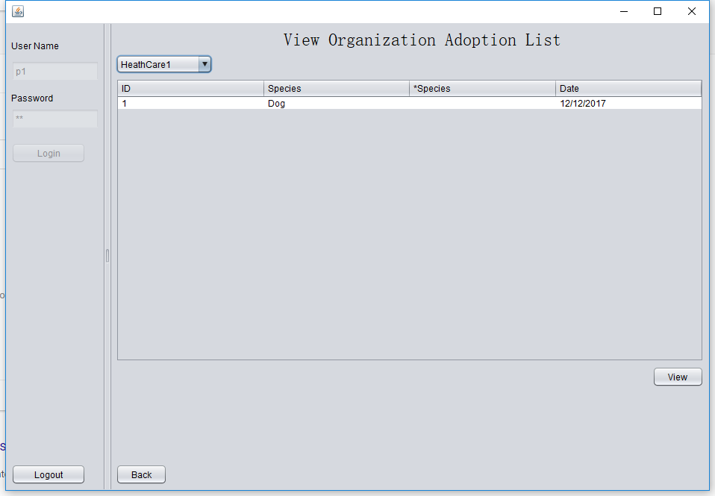
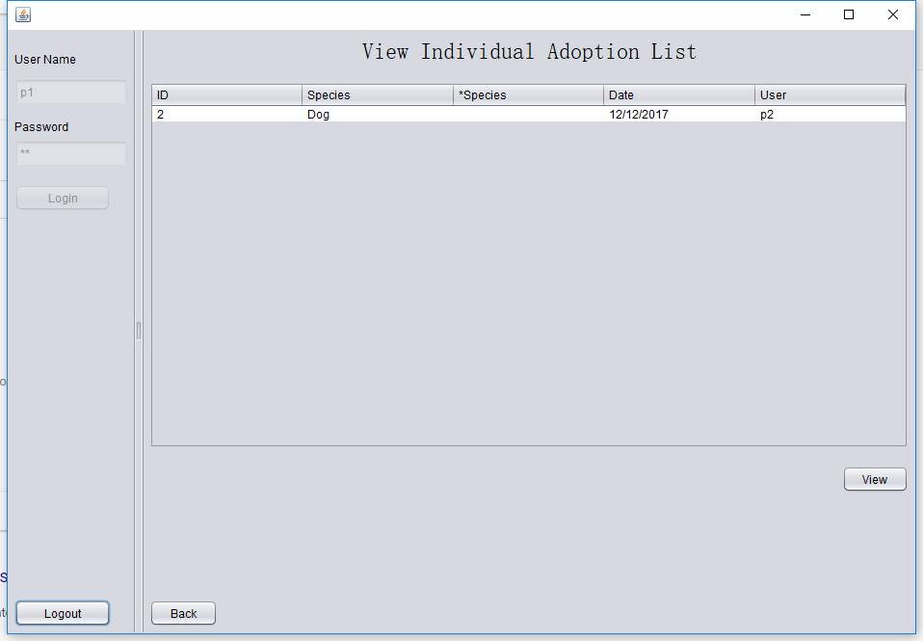
Use Case
Adoption Process (Pet Owner Side)
Pet Owners view adoption list from each animal health care department.
Individual adoption list by other pet owners in the same organization.

Slide 14
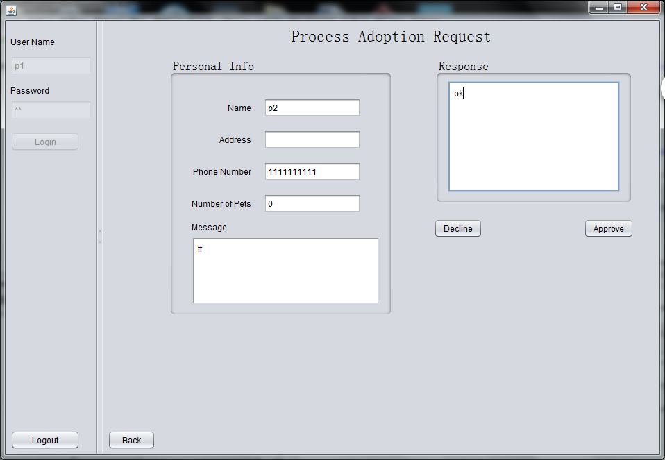
Use Case
Adoption Process (Pet Owner Side)
Pet Owners process request from other pet owners

Slide 15
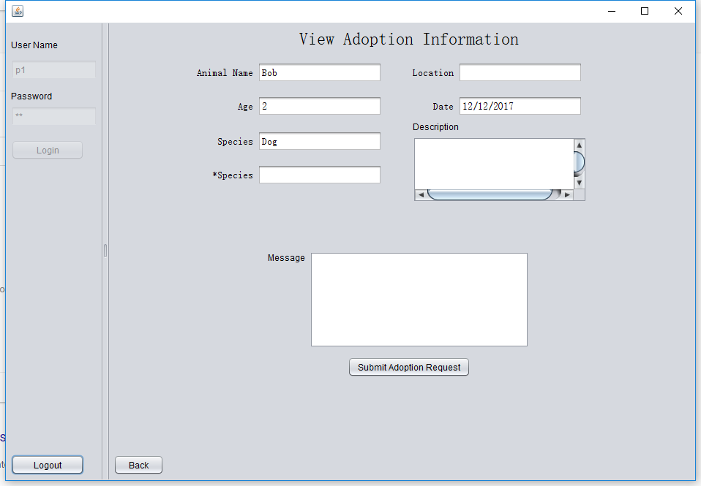
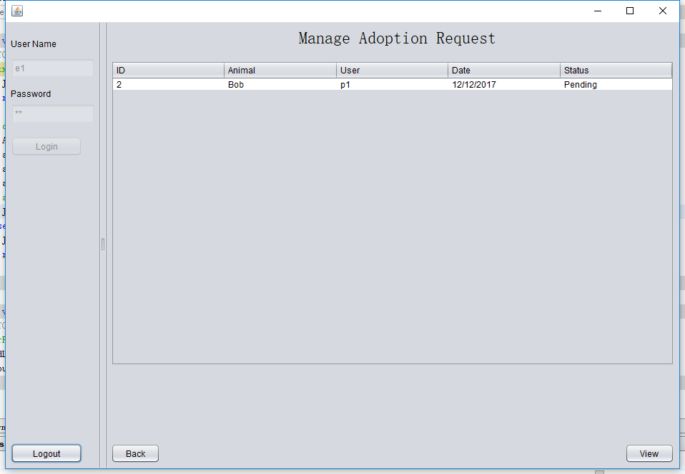
Continued
Employee check adoption request from users

Slide 16
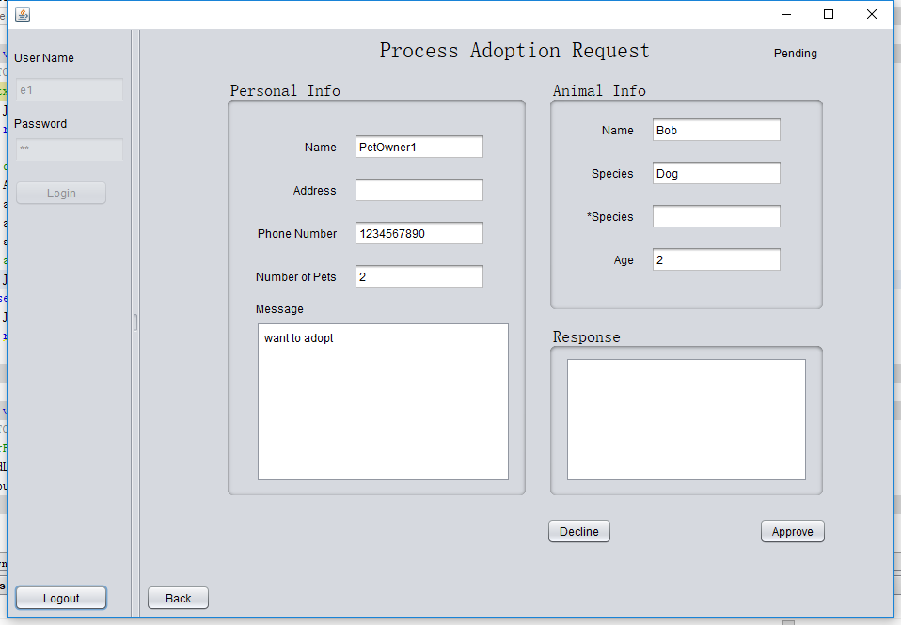
Use Case
Adoption Process (Animal Care Organization Side)
Employee approve/disapprove the adoption requests. Once a request has been approved, other request associated with the same animal will be rejected automatically and that animal will be removed from adoption list.

Slide 17
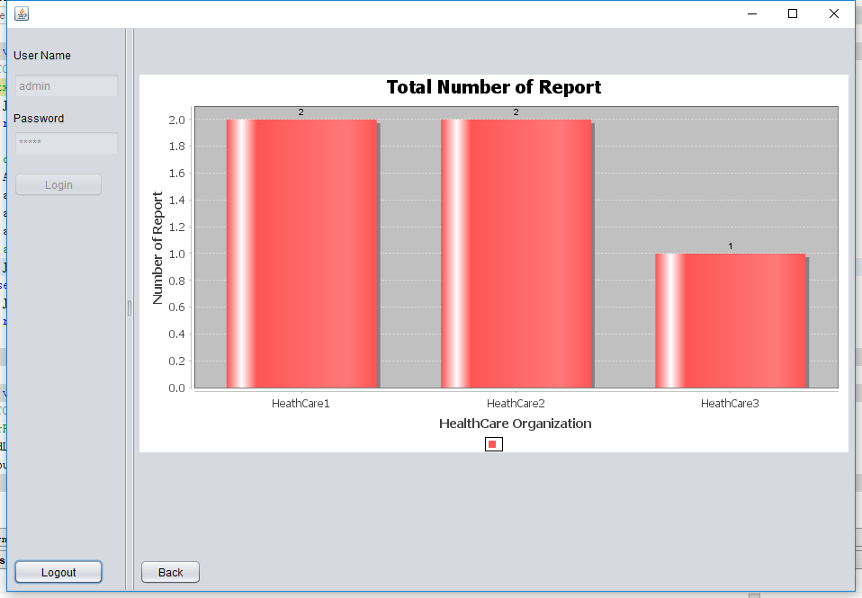
Analytical Functions
Number of reports for each department.

Slide 18
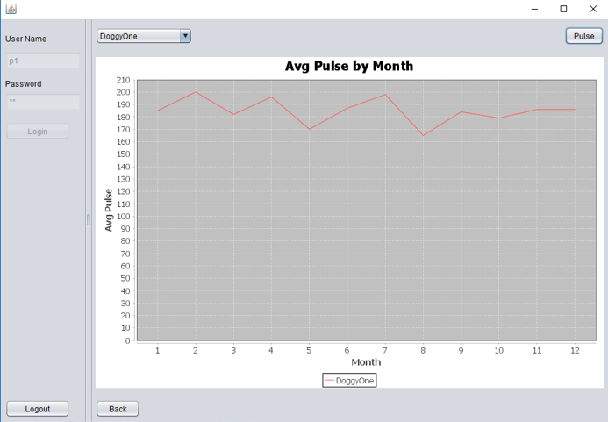
Analytic Functions
Just make a demo for demonstrating how to analyze the data in our object model. Because further analysis which make the result meaningful needs more research.

Slide 19
Thank you

